Slide 1
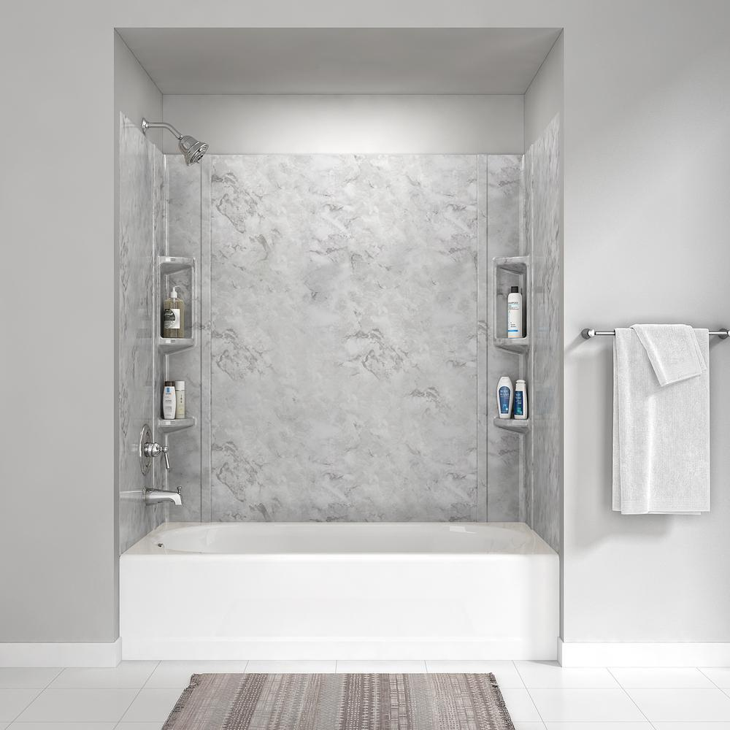





70° F|C
84 ° / 65 °
Humidity: 57%
08:10 AM
Friday, October 2019

Slide 2
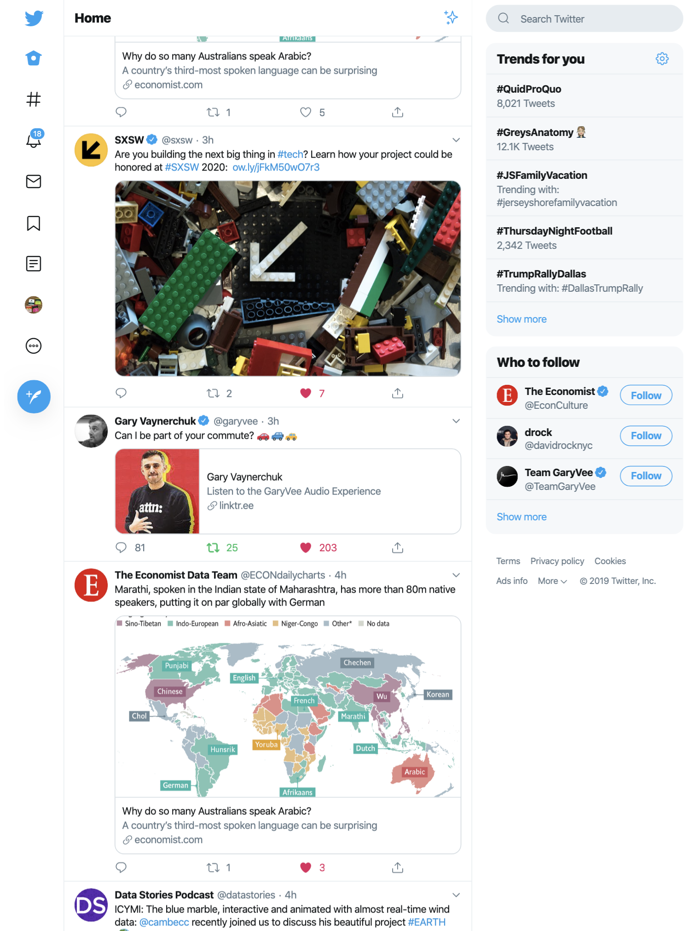
70° F|C
84 ° / 65 °
Humidity: 57%
08:10 AM
Friday, October 2019
Good morning, account@email.com
Upcoming events
Exercise 8:30 – 9:00 AM
Work 9:30 – 11:45 AM
Lunch 12:00 – 12:45 PM

